Slide 1
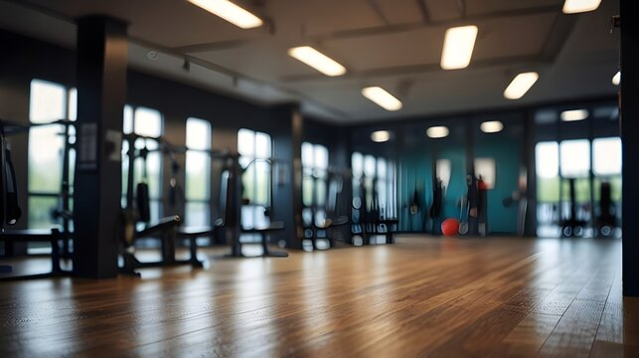
The Effect Of Workout Type And BMI On Calories Burned And Resting Heart Rate Among Gym Member
Subtitle
Notes:
NOTE:
To change the image on this slide, select the picture and delete it. Then click the Pictures icon in the placeholder to insert your own image.

Slide 2
Group Members
No. | Name
1.
2.
3.
4.

Slide 3
Executive Summary
The Study’s Focus
Analyze the impact of workout type and BMI on calories burned and resting BPM.
Statistical techniques: Descriptive stats, ANOVA, correlation, regression.
Findings
No significant difference between workout types on calories burned or resting BPM.
Weak correlation between BMI and calories burned.
BMI and gender do not predict resting BPM effectively.
Implications
Workout intensity and duration matter more than type.
Personalized plans yield better results.

Slide 4
Background
The significance of exercise
Benefits across physical, psychological, and social aspects.
RHR as a cardiovascular health predictor (link to exercise, endurance, and yoga).
Caloric expenditure as a tool for obesity management.
Factors affecting exercise outcomes
BMI and workout type.
Global context - Rising health awareness and the need for individualized training regimens.

Slide 5
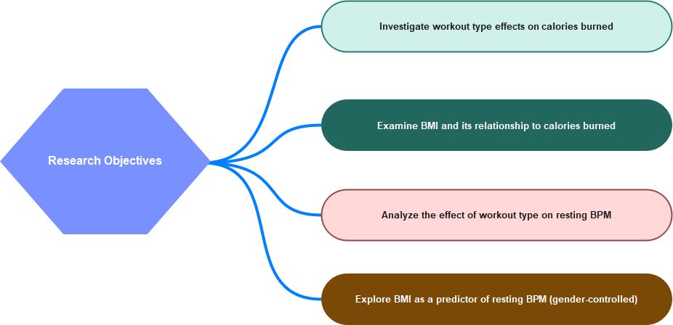
Research Objectives

Slide 6
Dataset Overview
Dataset size: 974 observations.
Variables
Independent: BMI, workout type.
Dependent: Calories burned, resting BPM.
Control: Gender.
Additional: Max/avg BPM, fat percentage, water intake, frequency, and experience.
Example data points
Gender, BMI, session duration, and workout frequency details.

Slide 7
Dataset Head
gym_members_exercise_tracking | Gender | Weight (kg) | Height (m) | Max_BPM | Avg_BPM | Resting_BPM | Session_Duration (hours) | Calories_Burned | Workout_Type | Fat_Percentage | Water_Intake (liters) | Workout_Frequency (days/week) | Experience_Level | BMI
56 | Male | 88.3 | 1.71 | 180 | 157 | 60 | 1.69 | 1313 | Yoga | 12.6 | 3.5 | 4 | 3 | 30.2
46 | Female | 74.9 | 1.53 | 179 | 151 | 66 | 1.3 | 883 | HIIT | 33.9 | 2.1 | 4 | 2 | 32
32 | Female | 68.1 | 1.66 | 167 | 122 | 54 | 1.11 | 677 | Cardio | 33.4 | 2.3 | 4 | 2 | 24.71
25 | Male | 53.2 | 1.7 | 190 | 164 | 56 | 0.59 | 532 | Strength | 28.8 | 2.1 | 3 | 1 | 18.41
38 | Male | 46.1 | 1.79 | 188 | 158 | 68 | 0.64 | 556 | Strength | 29.2 | 2.8 | 3 | 1 | 14.39
56 | Female | 58 | 1.68 | 168 | 156 | 74 | 1.59 | 1116 | HIIT | 15.5 | 2.7 | 5 | 3 | 20.55
36 | Male | 70.3 | 1.72 | 174 | 169 | 73 | 1.49 | 1385 | Cardio | 21.3 | 2.3 | 3 | 2 | 23.76
40 | Female | 69.7 | 1.51 | 189 | 141 | 64 | 1.27 | 895 | Cardio | 30.6 | 1.9 | 3 | 2 | 30.57
28 | Male | 121.7 | 1.94 | 185 | 127 | 52 | 1.03 | 719 | Strength | 28.9 | 2.6 | 4 | 2 | 32.34
28 | Male | 101.8 | 1.84 | 169 | 136 | 64 | 1.08 | 808 | Cardio | 29.7 | 2.7 | 3 | 1 | 30.07
41 | Male | 120.8 | 1.67 | 188 | 146 | 54 | 0.82 | 593 | HIIT | 20.5 | 3 | 2 | 1 | 43.31
53 | Male | 51.7 | 1.7 | 175 | 152 | 72 | 1.15 | 865 | HIIT | 23.6 | 3.5 | 3 | 2 | 17.89
57 | Male | 112.5 | 1.61 | 195 | 165 | 61 | 1.24 | 1013 | Cardio | 22.1 | 2.7 | 3 | 2 | 43.4
41 | Male | 94.5 | 2 | 179 | 136 | 69 | 1.18 | 794 | HIIT | 27.6 | 3.7 | 3 | 1 | 23.62
20 | Male | 117.7 | 1.81 | 196 | 161 | 54 | 1.35 | 1195 | Yoga | 26.4 | 3.3 | 3 | 2 | 35.93
39 | Female | 42.5 | 1.75 | 181 | 131 | 52 | 1.13 | 740 | Strength | 26.2 | 2.1 | 2 | 1 | 13.88

Slide 8
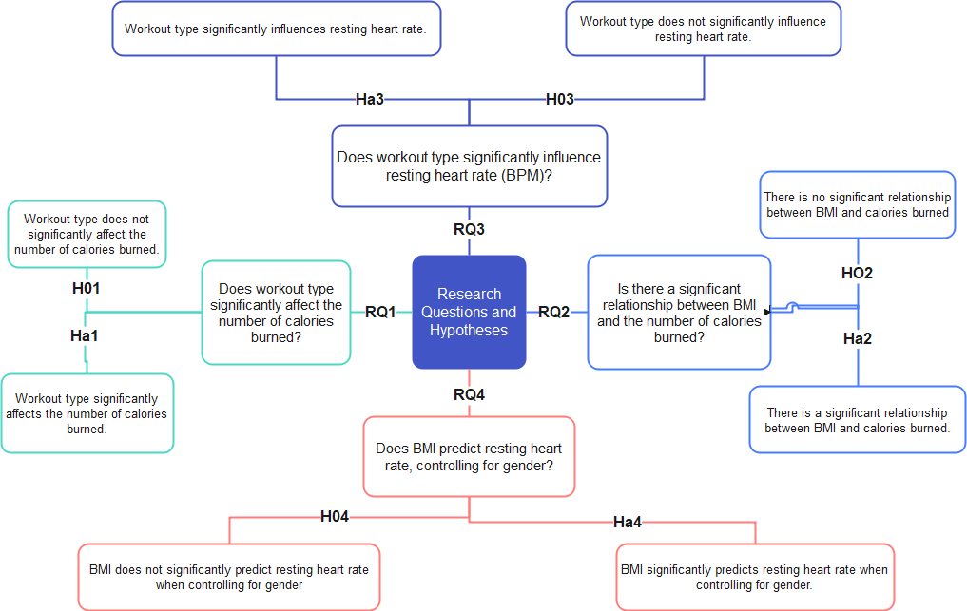
Research Questions and Hypotheses

Slide 9
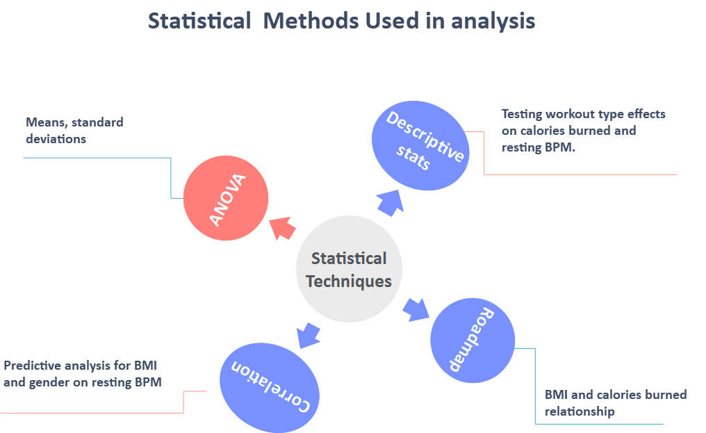
Research Design and Variables
Research Design
Quantitative approach.
Secondary dataset: Pre-collected, anonymized data.
Statistical tools: Descriptive stats, ANOVA, correlation, regression.
Key Variables
Independent: Workout type, BMI.
Dependent: Calories burned, resting BPM.
Control: Gender.
Additional: Session duration, water intake, etc.
Independent Var on Resting BPM
T-test &Multiple Reg
Calories- Male Vs Female

Slide 10
Descriptive Statistics Results
Key Measures (presented with ranges and means)
BMI: Mean = 24.91 (Normal category); Range = 12.32 to 49.84.
Resting BPM: Mean = 62.22 BPM; Normal range.
Calories Burned: Mean = 905.42; High variation due to differences in duration and intensity.
Interpretation of Descriptive Statistics
BMI indicates diverse body compositions among participants.
Stable resting BPM values suggest no significant outliers.
Calories burned show wide dispersion, likely due to differing exercise intensities.

Slide 11
One-Way ANOVA Results (Calories Burned)
Analysis
Comparison across workout types (Yoga, Cardio, HIIT, Strength).
Result: No significant difference (F = 0.949, p = 0.416).
Interpretation
Calories burned are not influenced by workout type.
Factors such as workout intensity and duration play a more significant role.
Practical Implication
Trainers should focus on customizing exercise plans for intensity and duration over type.

Slide 12
One-Way ANOVA Results (Resting BPM)
Analysis
Examined impact of workout type on resting BPM.
Result: No significant difference (F = 0.754, p = 0.520).
Interpretation
Resting BPM is more influenced by long-term cardiovascular fitness or genetics than workout type.
Practical Implication
Encourage consistent exercise regardless of type for cardiovascular benefits.

Slide 13
Correlation Results (BMI and Calories Burned)
Analysis
Pearson correlation coefficient: r = 0.059 (weak, positive).
Interpretation
Minimal relationship; BMI alone is a poor predictor of calories burned.
Higher BMI may slightly increase energy expenditure due to weight.
Practical Implication
Focus on personalized workout plans emphasizing other factors (e.g., intensity).

Slide 14
Multiple Regression Analysis (BMI and Resting BPM
The overall model was not significant: R² = 0.0091, F = 1.268, p = 0.263, suggesting that independent variables in concert cannot explain a statistically significant portion of variance in resting BPM.
longer workout sessions are associated with reduced resting heart rates.
the higher the caloric burn the higher the resting BPM, though marginally
The BMI, fat percentage, water intake, number of workouts, and experience didn't have a significant effect since their p values were > 0.05
Multiple R | 0.095476706
R Square | 0.009115801
Adjusted R Square | 0.00192804
Standard Error | 7.319993067
Observations | 973
ANOVA
 | df | SS | MS | F | Significance F
Regression | 7 | 475.6862607 | 67.9551801 | 1.268239363 | 0.262868329
Residual | 965 | 51706.91806 | 53.5822985
Total | 972 | 52182.60432
 | Coefficients | Standard Error | t Stat | P-value | Lower 95% | Upper 95% | Lower 95.0% | Upper 95.0%
Intercept | 65.87465082 | 3.200653457 | 20.5816255 | 2.55156E-78 | 59.5936074 | 72.15569423 | 59.5936074 | 72.15569423
Session_Duration (hours) | -4.790461303 | 1.863332969 | -2.570909968 | 0.010292049 | -8.447113119 | -1.133809486 | -8.447113119 | -1.133809486
Calories_Burned | 0.005179591 | 0.002149848 | 2.409281822 | 0.016170356 | 0.000960674 | 0.009398508 | 0.000960674 | 0.009398508
Fat_Percentage | -0.032154912 | 0.059989727 | -0.53600698 | 0.592077248 | -0.149880272 | 0.085570447 | -0.149880272 | 0.085570447
Water_Intake (liters) | -0.145837129 | 0.500476425 | -0.2913966 | 0.770810637 | -1.127984743 | 0.836310486 | -1.127984743 | 0.836310486
Workout_Frequency (days/week) | -0.215989987 | 0.470569008 | -0.458997475 | 0.646339345 | -1.139446528 | 0.707466555 | -1.139446528 | 0.707466555
Experience_Level | 0.479784129 | 0.727633762 | 0.659375849 | 0.509811765 | -0.948142796 | 1.907711054 | -0.948142796 | 1.907711054
BMI | -0.051669962 | 0.036400387 | -1.419489356 | 0.156079335 | -0.123103004 | 0.01976308 | -0.123103004 | 0.01976308

Slide 15
Independent Samples T-Test (Burned calories on Gender)
t-Test: Two-Sample Assuming Equal Variances
 | Female_Burned_calories | Male_burned_calories
Mean | 862.2489177 | 944.4559687
Variance | 62307.60602 | 82134.39365
Observations | 462 | 511
Pooled Variance | 72721.26378
Hypothesized Mean Difference | 0
df | 971
t Stat | -4.748466492
P(T<=t) one-tail | 1.17906E-06
t Critical one-tail | 1.646424413
P(T<=t) two-tail | 2.35812E-06
t Critical two-tail | 1.962410103
Based on the results there was indeed a statistical significant difference between the two groups: t = - 4.748, p < 0.001, two-tailed. Therefore, the male participants expended an average of 944.46 calories compared to females, Mean = 862.25.
That proves the interaction of gender with caloric expenditure in exercise sessions to be significant.

Slide 16
Statistical and non-statistical interpretation Summary
Descriptive Statistics
Provided a summary of BMI, calories burned, and resting BPM.
Showed variability across participants but no extreme outliers.
One-Way ANOVA
Tested differences in calories burned and resting BPM by workout type.
No significant differences were found between workout types (p > 0.05).
Independent Samples T-Test:
Showed that gender significantly influences calories burned (p < 0.001), with males burning more than females.
Multiple Linear Regression:
Revealed session duration significantly lowers resting BPM (p = 0.010).
BMI and calories burned had minimal predictive power on resting BPM.
Non-Statistical Implications
Workout type has minimal influence compared to intensity and duration.
Male participants burn more calories, likely due to physiological differences.
Longer workout sessions contribute to better cardiovascular health.

Slide 17
Results Based on Research Questions and Hypotheses
Research Question 1: Does workout type significantly affect the number of calories burned?
One-Way ANOVA showed no significant difference in calories burned between workout types (F = 0.949, p = 0.416).
Null Hypothesis (H₀1) is not rejected. Workout type does not significantly affect calories burned.
Other factors like session intensity and duration may have a greater influence.
Research Question 2: Is there a significant relationship between BMI and calories burned?
Pearson Correlation showed a weak positive correlation between BMI and calories burned (r = 0.059).
Null Hypothesis (H₀2) is not rejected. BMI has minimal influence on calories burned.
Research Question 3: Does workout type significantly influence resting heart rate?
One-Way ANOVA found no significant differences in resting BPM across workout types (F = 0.754, p = 0.520).
Null Hypothesis (H₀3) is not rejected. Resting BPM is more influenced by long-term cardiovascular fitness than workout type.
Research Question 4: Does BMI predict resting heart rate, controlling for gender?
Multiple Linear Regression revealed BMI and gender did not significantly predict resting BPM (R² = 0.0017, p = 0.436).
Null Hypothesis (H₀4) is not rejected. BMI and gender have minimal impact on resting BPM.
Additional
Gender and Calories Burned: Independent samples t-test showed that males burned significantly more calories than females (t = -4.748, p < 0.001).

Slide 18
Conclusion
Summary of Key Findings
Workout type had no significant effect on calories burned or resting BPM.
Gender significantly impacts calories burned, with males expending more energy.
BMI was weakly correlated with calories burned and had no significant influence on resting BPM.
Session duration was the most significant factor affecting resting BPM, showing its importance for cardiovascular health.
Interpretation
Individual workout outcomes depend on factors beyond workout type, such as intensity, duration, and personal fitness levels.
Tailoring workouts to individual characteristics is essential for optimal results.

Slide 19
Recommendations
For Fitness Trainers
Focus on session duration and intensity rather than type of workout to maximize calories burned and cardiovascular benefits.
Use gender-specific caloric burn rates when designing personalized workout plans.
For Gym Members
Incorporate longer aerobic or endurance sessions for improved heart health.
Explore HIIT workouts for weight loss goals due to their high-calorie burn potential.
For Future Research
Investigate additional factors like age, metabolic rate, and workout intensity to provide more accurate predictors of exercise outcomes.

Slide 20
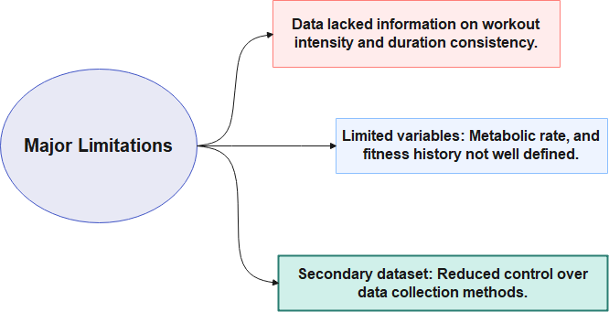

Limitations of the Study

Slide 21
Call to Action
Key Takeaways
Fitness outcomes are complex and influenced by factors beyond workout type.
Personalized plans focusing on duration and intensity deliver the best results.
Call to Action
Gym trainers and members should embrace data-driven approaches to design and implement personalized fitness programs.
Researchers should conduct broader studies, incorporating diverse variables, to advance the understanding of fitness outcomes.

Slide 22
References
CXOLearningAcademy (2020). Statistics in Excel Tutorial 1.1. Descriptive Statistics Using Microsoft Excel. [online] www.youtube.com. Available at: https://www.youtube.com/watch?v=3F_V5alJubk [Accessed 17 Nov. 2024].
Binsaeed, B.S., Aljohani, F.G., Faisal, M.D. Huda Alraddadi, Alrehaili, A.A., Alnahdi, B.S., Almotairi, F.S., Mohammed Al Jumah and Abdullah AlRehaili (2023). Barriers and Motivators to Weight Loss in People with Obesity. Cureus, [online] 15(11). doi:https://doi.org/10.7759/cureus.49040.
Kato, B. (2024). I’m a Personal Trainer — These Are the 6 Simplest and Most Effective Exercises to Burn Calories. [online] New York Post. Available at: https://nypost.com/2024/08/31/lifestyle/im-a-personal-trainer-these-are-the-6-simplest-and-most-effective-exercises-to-burn-calories/?utm_source=chatgpt.com [Accessed 17 Nov. 2024].
Laerd Statistics (2018). One-way ANOVA - an Introduction to When You Should Run This Test and the Test Hypothesis. [online] Laerd.com. Available at: https://statistics.laerd.com/statistical-guides/one-way-anova-statistical-guide.php [Accessed 17 Nov. 2024].
McCombes, S. (2021). How to Create a Research Design. [online] Scribbr. Available at: https://www.scribbr.com/methodology/research-design/ [Accessed 17 Nov. 2024].
Reimers, A., Knapp, G. and Reimers, C.-D. (2018). Effects of Exercise on the Resting Heart Rate: a Systematic Review and Meta-Analysis of Interventional Studies. Journal of Clinical Medicine, [online] 7(12), p.503. doi:https://doi.org/10.3390/jcm7120503.

